Slide 1
Use of cars
Cars are the preferred means of transport by many
There is everyday manufacture of cars to cater fro transport needs (Marzotto, Burnor, & Bonham, 2015).
Increase in household income over the years has increased the demand and use of cars.

Slide 2
Reason for choosing the topic
There has been an increase in the use of cars over time.
The advantages of cars may make people overlook the disadvantages.
There are few reliable alternatives to fuel cars as means of transport (Marzotto, Burnor, & Bonham, 2015).

Slide 3
Cars and the environment
Various activities related to use of cars
  The production and disposal of cars
  The use of cars as means of transport
  The fuel production
  Development of infrastructure like roads

Slide 4
Production of cars
Production of land requires the large space to set up the production plant and industry.
  This can influence destruction of environment including deforestation (McCarthy, 2017).
  The process can destroy natural habitats
  The production plant may emit gasses to the air which are a cause of pollution.

Slide 5
Production of cars: cont.’
Production of cars requires natural materials such as steel, plastic and rubber .
  Mining required to acquire the metal destroys the natural habitats (McCarthy, 2017).
Natural rubber required in making the wheels and other parts of the cars can influence destruction of trees.

Slide 6
Cars as means of transport
Use of cars is a leading cause of air pollution
  Vehicles emit toxins such as carbon monoxide and smog
  Vehicles which are not roadworthy emit gases which pollute the air required by humans and animals for breathing (Sharma, et al, 2020).
Pollution of air can influence climate change
Auto emissions from cars are an immediate health concern when breathed directly to the lungs

Slide 7
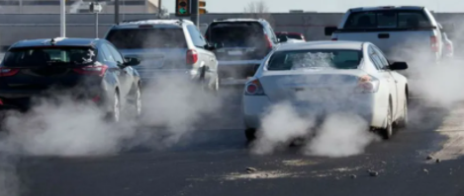
Air pollution by cars

Slide 8
The cost of fuel
Production of petroleum and petroleum products required by cars is an energy intensive process.
  The process can damage the local ecosystems (Sharma, et al, 2020).
Shipping of fuels is also energy consuming and may also pollute the environment in cases of oil spillage.
The increase in demand of cars has increased the demand for fuel and hence the overexploitation of the natural sources of fuel.

Slide 9
cars AND INFRUCTRUTURE
Forests and natural habitats are destroyed for the construction of roads (Di Pascoli, Femia & Luzzati 2018).
Construction process requires burning of fossil fuels which pollute the atmosphere
  Burning fossil fuels can also lead to the release of greenhouse gases which harm the environment
There are numerous waste materials which end up in landfills
Infrastructure construction is also responsible noise pollution as well as mass dust generation

Slide 10
Disposal of cars
Disposal of cars as scrap metals increases the amount of metals in landfills
Disposal of plastic car parts is major cause of soil pollution (Di Pascoli, Femia & Luzzati 2018).
Disposal of cars can influence the release of gases like methane when the car waste decomposes.

Slide 11
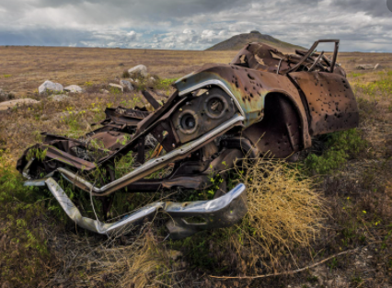
Poor disposal of car waste

Slide 12
Possible alternatives
There are various alternatives which can help in protecting the environment
  Carpool for long commuters to reduce the use of fuel
  The use of public transportation instead of personal cars which influence high emission of gases into the environment (McCarthy, 2017).
Use of electric cars reduces the emission of pollutant gases to the atmosphere
Use of bikes for short distance commuters

Slide 13
Conclusion
The manufacture, use and disposal of cars can damage the environment
Fossil fuels used in cars are a cause of air pollution
Manufacture of vehicles influences deforestation to set up plants which also emit gasses to the atmosphere.
Construction of roads is responsible for mass generation of dust (Sharma, et al, 2020).

Slide 14
References
Di Pascoli, S., Femia, A., & Luzzati, T. (2018). Natural gas, cars and the environment. A (relatively)‘clean’and cheap fuel looking for users. Ecological Economics, 38(2), 179-189.
Marzotto, T., Burnor, V. M., & Bonham, G. S. (2015). The evolution of public policy: Cars and the environment. Lynne Rienner Publishers.
McCarthy, T. (2017). Auto mania: cars, consumers, and the environment. Yale University Press.
Sharma, V. K., Fortuna, F. A. B. I. O., Mincarini, M. A. R. C. E. L. L. O., Berillo, M., & Cornacchia, G. I. A. C. I. N. T. O. (2020). Disposal of waste tyres for energy recovery and safe environment. Applied Energy, 65(1-4), 381-394.

